Slide 1
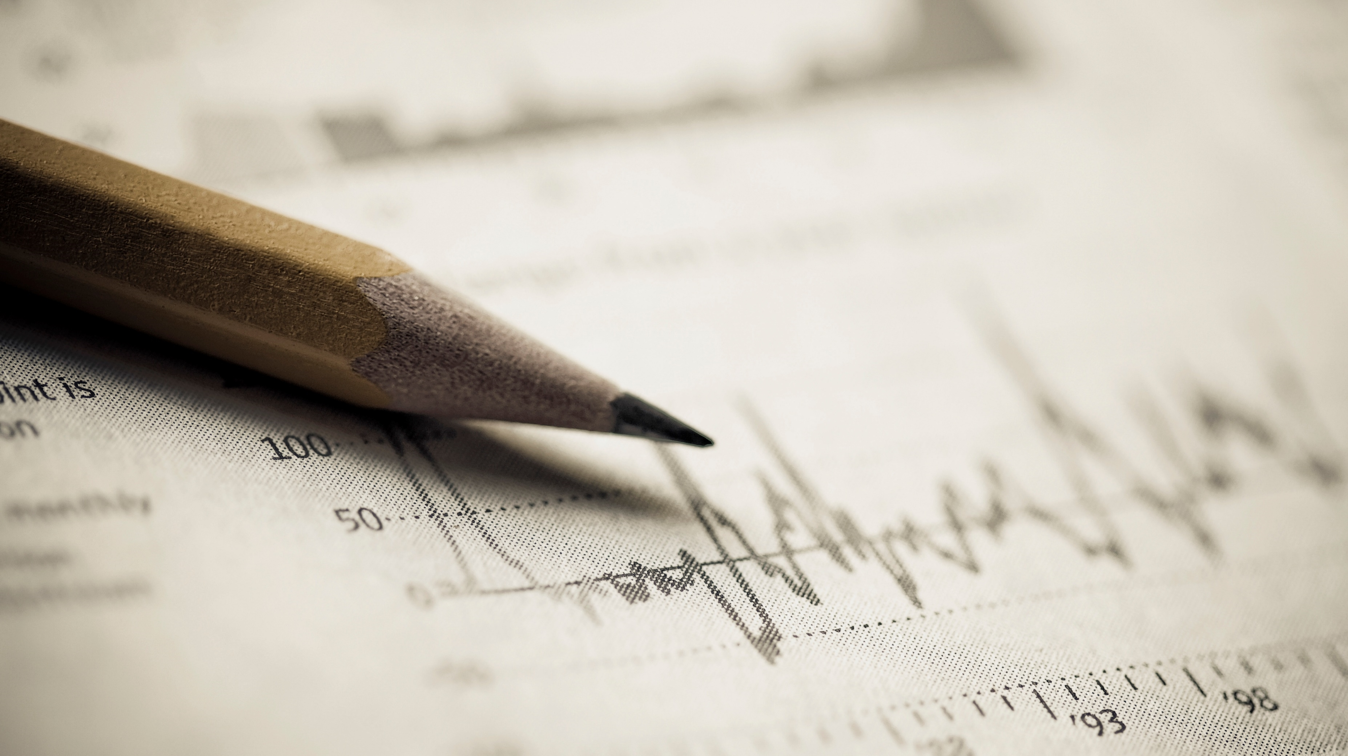
AI in Trading and Investments
AIFA project

Slide 2
GROUP MEMBERS
Gaurav Malakar
20CS10029
Mir Mohammad Wasif 20CS10035
Atishay Jain
20CS30008
Roopak Priydarshi
20CS30042

Slide 3
Introduction
Technology is playing a remarkably significant role in everyday experiences. It has revolutionized almost every aspect of people’s lives, including financial trading and investing. Trading and investing in the stock markets has not been this simple ever before and advancements in technology have paved the ground for AI to involve in various trading and investing processes. AI goal which simulates human intelligence, is that machines learn and do problem-solving as humans do with less cost and less time.

Slide 4
Objective
This thesis aims to identify AI’s influences and the changes it brings in trading and investing in financial markets and produce a reliable outcome for humans compared to AI or machines in trading in stock markets. This thesis researches and analyses the following factors:
• The role of AI’s development in the finance and finance industry
• The possible changes AI brings to investing and trading methods in financial markets
• The applicability of AI and its parts and enablers in various processes are also discussed

Slide 5
Financial market and investing
Financial Markets, one of the most intricate human beings, are being affected by technology expansion and growth. Technology is easing human’s access to trade on stock markets in many ways. People can trade any amount of money using only a mobile phone and an application in its simplest form. There has been much progress in how trades and investments happen, but the idea behind it remains the same; means that the markets have not ever been beaten or overtaken by only one individual, sector, or company. Thus, technology development and mostly artificial intelligence are effective approaches that many financial companies and experts in finance sectors focus on to benefit the utmost.

Slide 6
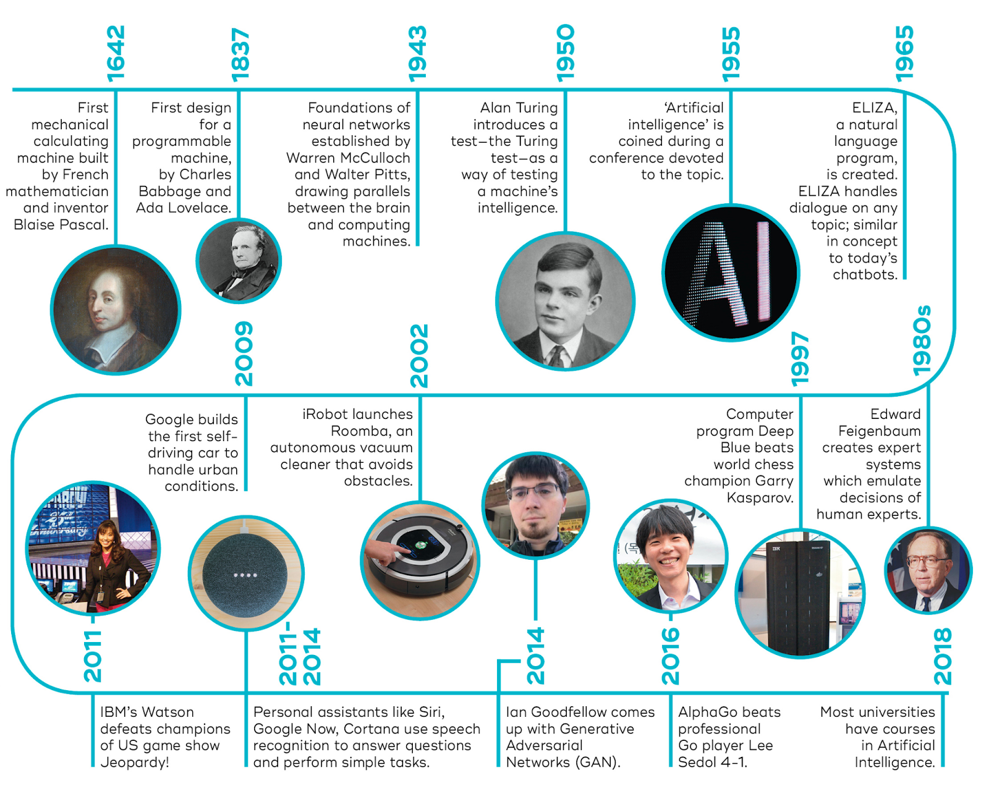
AI TIMELINE

Slide 7
AI-Based Trading
AI is used in a vast range, from digital marketing to user experience enhancement and investing.
AI is used in tax departments to turn the losses into tax deductions.
Stock trading is evolving, and the trading process with AI is getting more lenient.
AI is used in many kinds of investments or stock trading.
With the help of AI, portfolios could expand into a broader range, such as real estate, debt investments, reputation management, biotech startups, and investing in the stock market.

Slide 8
AI-Application in trading
There are three main ways AI has been applied in trading:
Discovering patterns
Predictive trading based on sentiment
Speed trading

Slide 9
Predictability of stock price fluctuations
Predicting the market can be one main reason that there is so much focus on the technology side, especially AI in financial institutions and hedge fund companies. Using AI, many simple and routine tasks that are more time-consuming are processed, taking less time and cost less, and give the employees more time to focus on the more critical tasks and decisions.
Predicting the news that affects the stock prices is what is meant to look for instead of predicting the price itself. Market dynamics are caused by the decision of thousands of investor decisions and human bias in trading parallels and the market changes in case of any crash or chaos. That randomizes the fluctuation and price sequence, especially when comparing a daily or weekly chart where widespread tops and downs and a yearly chart show that prices are constantly fluctuating. It tells that there is a pattern to this constant stability, and those patterns are where AI shines.
Prediction of fluctuations in the market could bring considerable amounts of wealth. Many people in various fields are working hard to develop such models and tools to predict the next market moves. Frequent aspects can affect the market’s predictability, like how fast the market’s there digest publicly available information and information efficiency.

Slide 10
Discovering Patterns
Incredibly powerful computers can crunch almost countless data points in minutes. It means they can also detect historical and replicating patterns for smart trading that are often hidden from human investors. AI can assess hundreds and thousands of stocks in flashes. Humans are not capable of processing that amount of data or seeing these patterns at the same rate as technology. For example, using AI technology, some hedge funds evaluate more than a hundred million data points in the first hour when markets open.

Slide 11
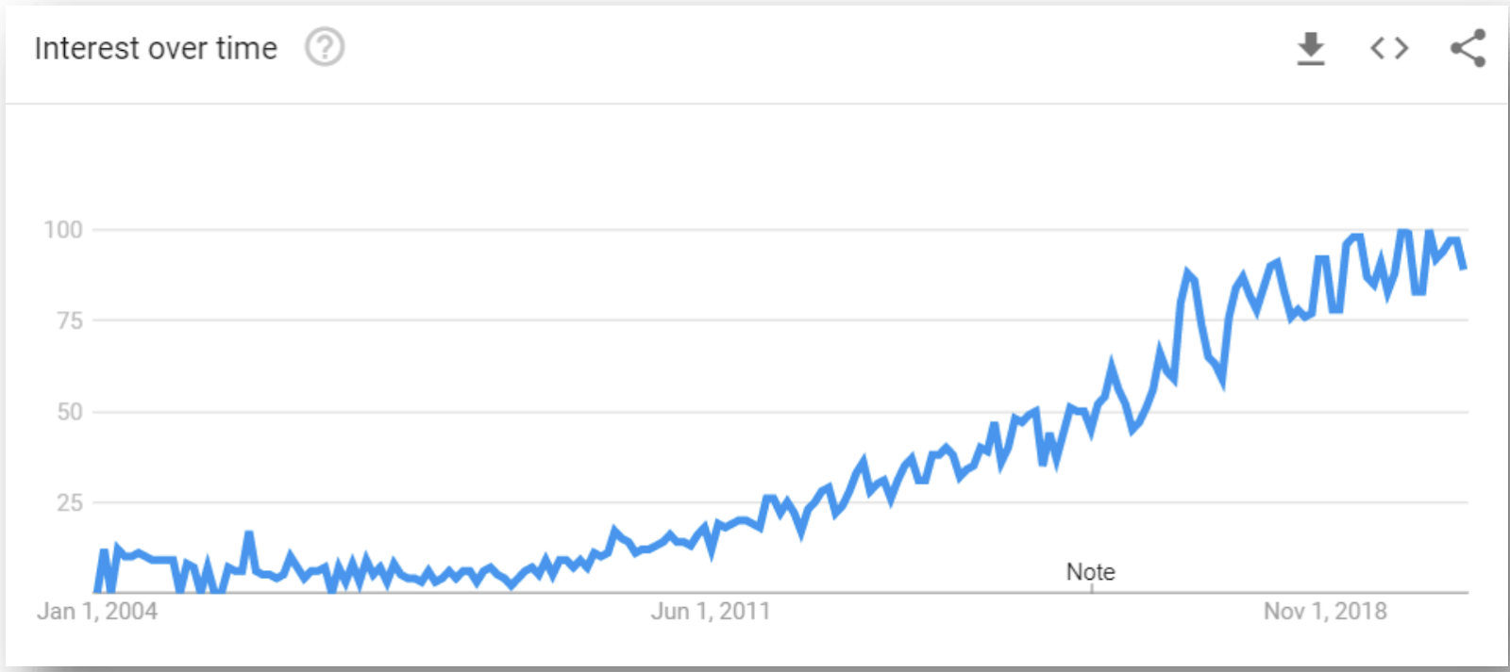
Predictive trading based on sentiment
Using sentiment analysis, AI analyses headlines, social media comments, blogs, articles, and more data to find the direction of the stocks and performance or move of other traders.
According to Google Trends, the word “sentiment analysis” has gained steady traction over the past five years. In trading, the sentiment is used to show whether a trade should go long or short. Sentiment analysis are often used in long stocks 20 when there is good or positive news about a company and short stocks if there is negative information about the company.
Sentiment analysis trend over time (2004 – 2018)

Slide 12
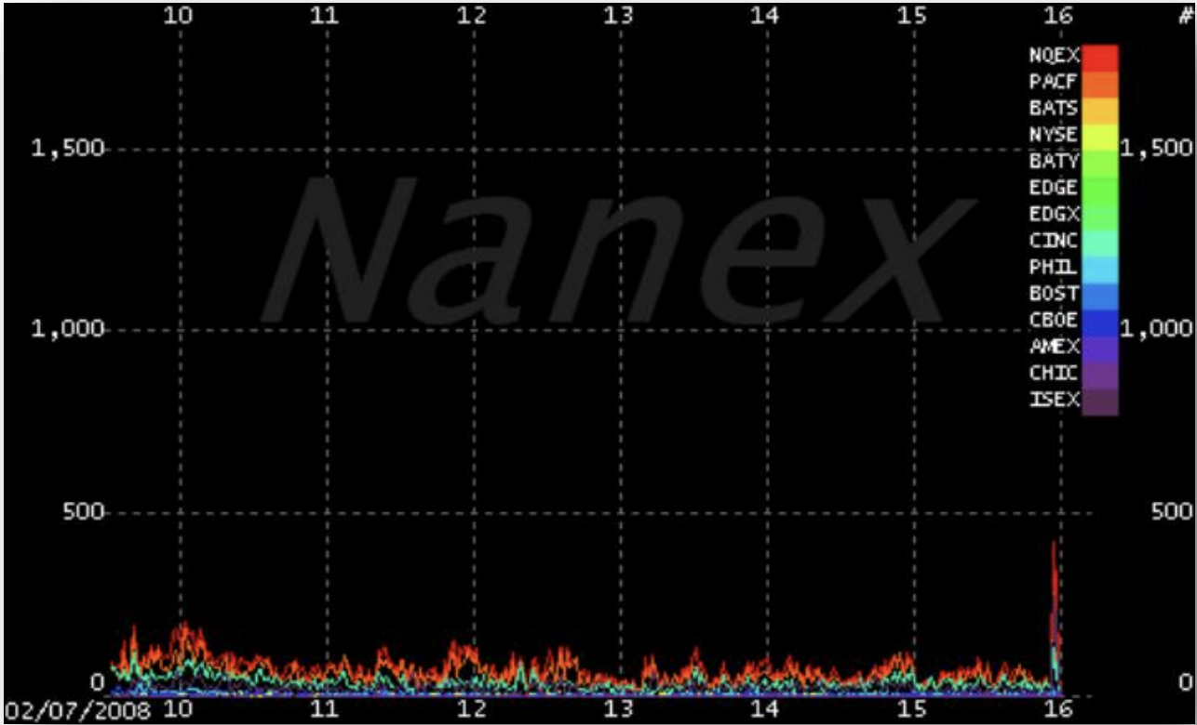
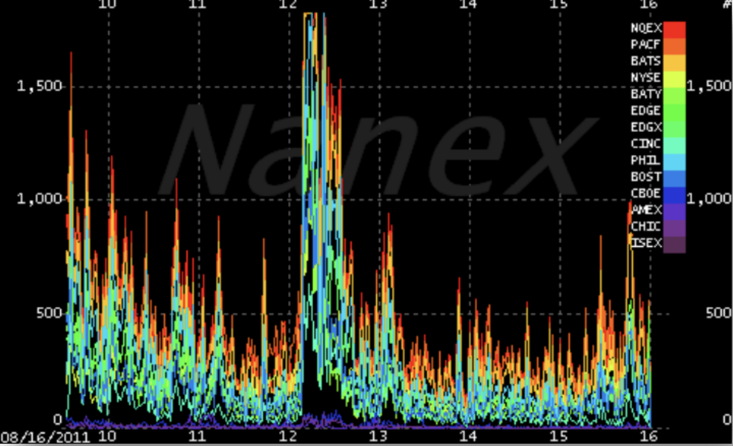
Speed Trading
High-speed trading is unnerving financial markets. Algorithmic trading allows financial firms to detect and utilize market movements and patterns at lightning speeds that bring huge profits. The graphs below show the difference in trading activity in the year 2008 compared to 2011. In 2011 the activity got frantic and erratic.
High-frequency trading in 2008
High-frequency trading in 2011

Slide 13
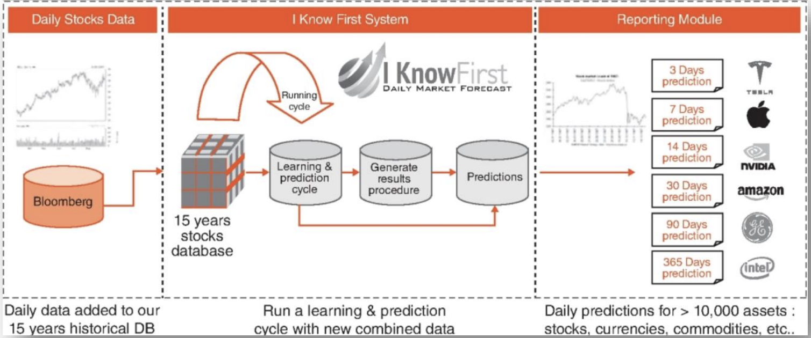
Investing using AI-driven decision enhancement tools
In investing, AI is used to predict stock prices; thus, algorithms are supposed to be trained in a set of historical trading data, such as ten or fifteen years of trading data. “I Know the first,” is an AI project, created by utilizing the reinforcement learning techniques. In this technique, the algorithm recalibrates its current findings to avoid relying on prior results with the possibility of another emerging pattern.
The AI in investing predicts the price data fluctuations based on both old and current data. In the first phase, it accounts for all the given data related to stock prices. The difference achieved by using AI in trading as compared to humans is that it is not being affected by emotions, but by the exact numbers of highs and lows of both up and down trends.
The cycle of an AI project algorithm which uses both updated market data and historical trading

Slide 14
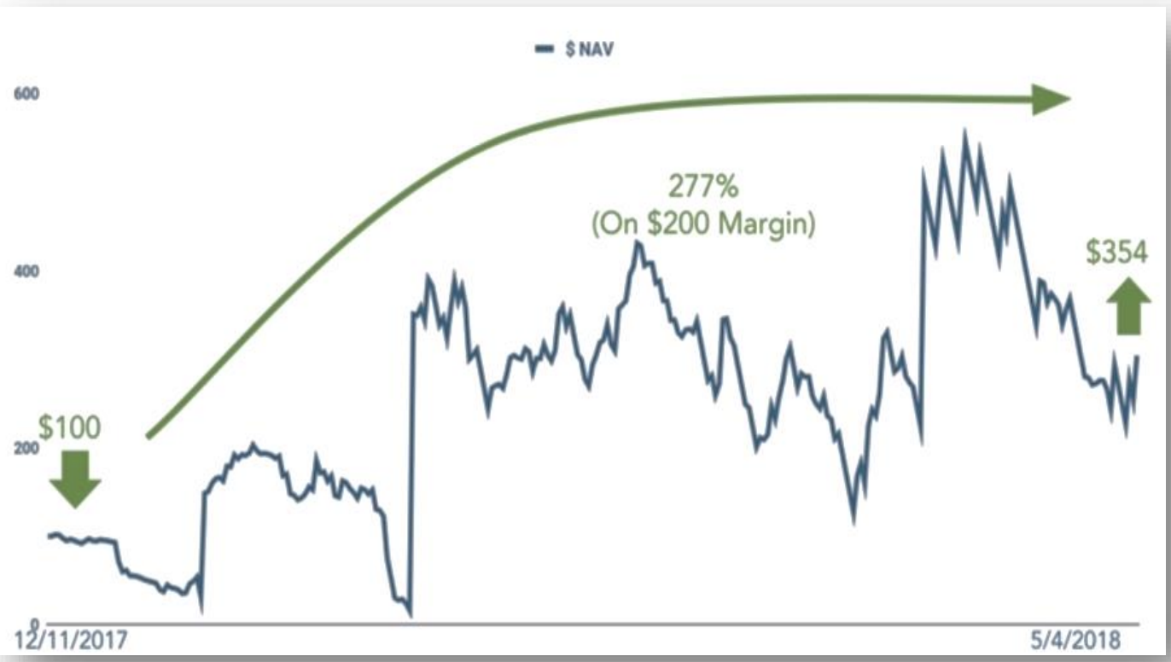
Technical indicators and patterns
In the markets, technical analysis indicators are used for spotting the change in prices regarding volume and different time frames. There are more than a hundred indicators that could be found. Some indicators are used more than the others because they are different according to the markets, whether it is stocks or FOREX, or because of simplicity contrasted with complexity.
The hedge fund industry manages $3.5 Trillion, and AI has been used in the industry, but the outcome is not that overwhelming compared to its application in the other sectors. There are different markets and a ton of data in the financial industry. At Wall Street, people worked hard to replace various tasks with AI and AI-driven tools. The attempt is that AI brings better changes and do better than humans. The computers do about 90% of trades in the financial markets, and the human behind it hardly codes the robust algorithms.
Trading EUR USD

Slide 15

Use of the constraint satisfaction problem in Trading?
The rapid growth of High frequency in recent years have brought into light the use of Big Data in Trading industry. The estimation of security volatility in high frequency trading remains a challenge in business analytics. However, according to some of the recent AI papers, a novel section volatility estimation model can be designed and implemented via a big data analytics approach.
In this presentation we also explore to another AI paper which proposes a graph‑based big data optimization approach using hidden Markov model and constraint satisfaction problem. The main role of the constraint satisfaction problem in this optimization process is reducing the size of search space.

Slide 16
Hidden Markov Models in Big Data Optimization
The use of HMMs in financial time series applications faces a range of challenges. Researchers have been working on the main problems in connection with HMMs. Thus, many works have focused on the improvement of existing approaches or the search for new solutions to the prediction problem or the evaluation problem. The proposed approaches aim to find solutions to four problems:
The choice of model topology (e.g., the number of hidden states and observations and type of connections);
The search for the initial parameters;
The search for the model parameters; and
The reduction of the search space. Despite the progress made, these works nevertheless face multiple obstacles that hamper their speed and efficiency.
In the real world, a main challenge for hidden Markov model problems (e.g., stock market prediction) is the high dimensionality of the state space (N) and/or observation space (M). The objective is to provide a solution quickly enough that the system can give a result in a reasonable time without losing accuracy.

Slide 17
Link between HMM and CSP
Given their power and their excellent performance in several applications, the use of HMMs in the big data context is common. However, to obtain good results, new methods must be found to optimize these algorithms. We are particularly interested in two characteristics of HMMs: the high number of states and the high number of observations. In this approach, we propose an optimization technique using metaheuristics based on the CSP. Treating a problem as a CSP confers several important benefits.
CSP resolution methods can be applied to reduce the state space of an HMM since the representation of a CSP conforms to a standard HMM model, i.e., a set of variables (states) with assigned values and a set of containers (state transitions and/or other external constraints). The use of CSPs to reduce the number of states or observations and therefore improve the performance of HMMs is justified by the power of their solver algorithms and because HMMs and CSPs can be seen and treated in the same way from a graphical point of view. Thus, the structure of the constraint graph can be used to simplify the solution process, in many cases conferring an exponential reduction in complexity and making it possible to improve the learning and prediction phases using HMMs.

Slide 18
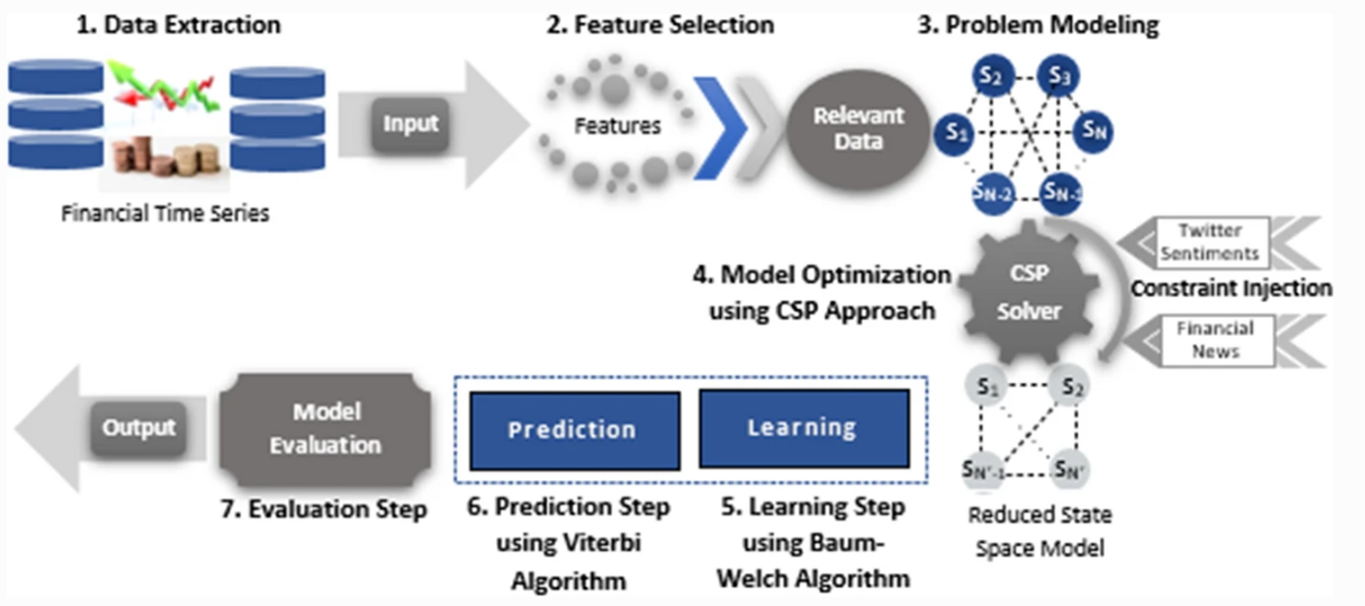
Schematic representation of the proposed approach

Slide 19
Trading via Image Classification
To help traders make better decisions about whether to purchase or sell a particular investment, many algorithms have been created to evaluate continuous financial time-series data. Financial time-series analysis can be thought of as a visual process. We produce large amounts of financial time-series visual data. It is advised to use the strength of computer vision algorithms for time-series classification by first encoding the data as pictures. Trading is continuous, but we only take into consideration the start, max, min, and finish values per stock every day since we employ a discrete representation of the continuous data.

Slide 20
Box-and-whisker Diagram
We visualize the data using a box-and-whisker (also called candlestick) diagram, where box edges mark the Open and Close price, while the whiskers mark the Low and High values. The color of each box reveals whether the Open price finalized higher or lower than the Close price for the same day; if Open > Close the box in filled in black, if Open < Close the box is filled in white. If a trader decides to follow the signals they may do so at any point no earlier than the day after the opportunity signal was created.

Slide 21
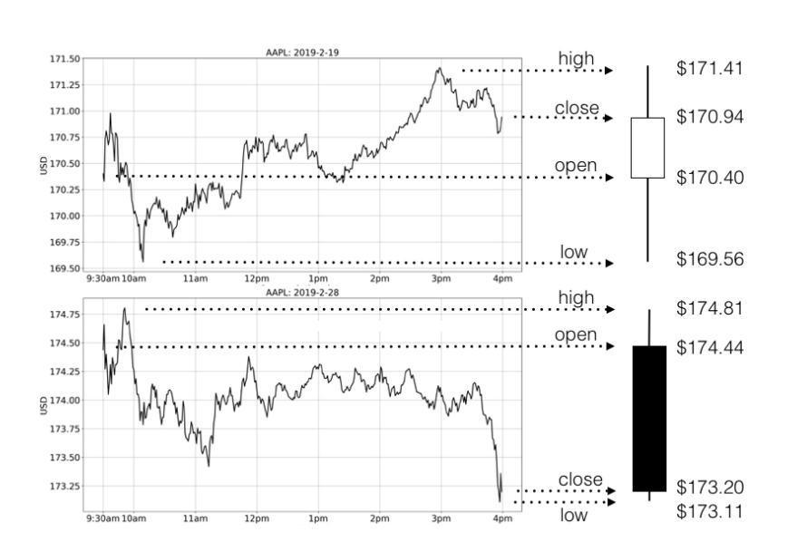


Slide 22
Results achieved by Trading via Image Classification
Visual object recognition and object detection using machine learn-
ing and deep neural networks have shown great success in recent
years. We focus on financial trading after noticing that human
traders always execute their trade orders while observing images of
financial time-series on their screens. Recent studies suggest
that the transformation of time-series analysis to a computer vision
task is beneficial for identifying trade decisions typical for humans
using technical analysis.

Slide 23
AI-Trading versus Traditional Trading methods
Traditional investors collect daily data from the news or other sources. They read charts, analyze past data, and use various kinds of strategies. In contrast, a Robo-analyst uses computer programs with applications that can analyze a massive amount of data, generate more objectives, and recommend more stock pickings than traditional or human investors. The considerable difference between the two appears in the cost of each approach. A human investor may charge or get less salary regularly since a programmed Robo-analyst is expensive to build and program at the beginning. Later it just needs scaling and setting or feeding proper inputs. Compared to AI trading, traditional trading methods or human trading methods differs in several ways, considering different time frames such as short-term and long-term investing. Computers and AI have some distinct plusses, mostly seen in short-term investing rather than long-term investing in various companies. In AI, automated trading algorithm systems have developed quicker than expected, and AI-driven investment platforms are considerably growing. That makes the traders and investors believe that AI is the future of trading.

Slide 24
Conclusion
Even though AI has been around for a long time, it is still called an emerging topic. That is due to its steady and surprising development in every industry, including finance. AI has shown major improvements in different finance processes, especially when it comes to investing and trading. Trading and investing in assets in stock markets is a big part of finance. Many individuals and small or big finance companies are competing to benefit using AI in their strategies. Competency and seeing opportunity in AI and its capability shows different aspects of the topic. First, humans who have started trading hundreds of years ago, and then there comes AI, machine learning, algorithms, which are overtaking humans at some points.

Slide 25
References
Importance of Big Data in High Frequency Trading:
https://rdcu.be/cZnbk
Advantages and disadvantages of aI-based trading and investing versus traditional methods: https://www.theseus.fi/bitstream/handle/10024/347449/Waisi_Mirwais.pdf
Trading via Image Classification: https://dl.acm.org/doi/pdf/10.1145/3383455.3422544

